Slide 1
Predictive and Prescriptive Data Analytics for Enhancing Security Decisions in Network Management
Your Name: Saif Kamal Salim Haddad
Your ID: 21110214
Date: 5-9-2023

Slide 2

Predictive Analytics

Slide 3

Predictive Techniques Used
Feature selection used:
1- Select-K-best:
The need for this technique:
chooses the top K features according to each individual's statistical value.
How it works:
Every feature is assessed separately
using a statistical test (calculate the score) scoring function (f_regrssion)
to see how it relates to the target variable.
The top K features with the highest test scores are chosen
after features are rated according to their test results.
(Selectkbest, 2014)

Slide 4
Predictive Techniques Used
Feature selection used:
1- Sequential Feature Selection:
The need for this technique:
Choose a subset of features by doing iterations including or excluding features according to specified criteria.
How it works:
Start with an empty feature set (forward selection)
Add one feature at a time to the set based on the evaluation criteria (performance)
Using the chosen features, evaluate the model's performance.
Keep track of the feature set with the greatest performance.
Repeat these steps until the needed number of feature are selected
(Malato, 2023)

Slide 5
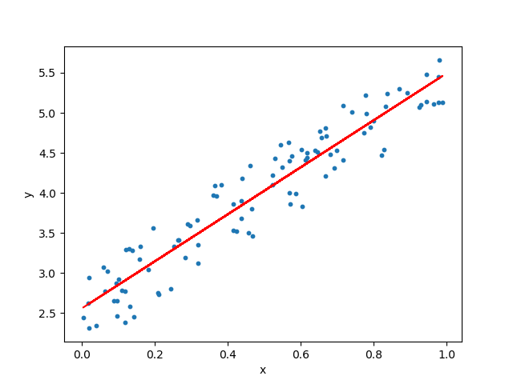
Predictive Techniques Used
Regression models used:
1- Linear regression:
The need for this model:
Represents the relationship as a linear equation between the target as the dependent feature and one or more feature as the independent variables. (Mali, 2023)
How it works:
LR tries to fit a line with no curves (straight line). (Mali, 2023)

Slide 6
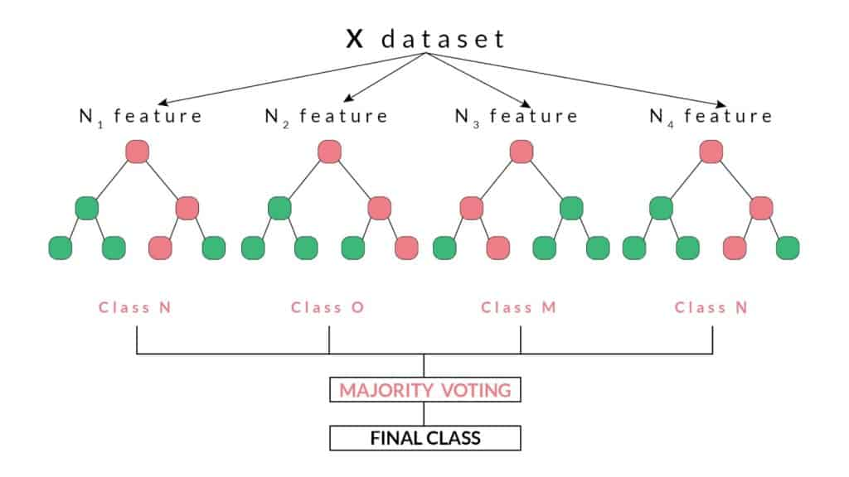
Predictive Techniques Used
Regression models used:
2- Random Forest Regression (RFR):
The need for this model:
Blends multiple decision trees to make accurate predictions. (Beheshti, 2022)
How it works:
creates a collection of decision trees
Each tree is trained on a random subset of features
Predictions are made by taking the averaging of the subtrees (Beheshti, 2022)

Slide 7

Predictive Techniques Used
Regression models used:
3- Decision Tree Regression (DTR):
The need for this model:
represents data as a decision-and-outcome tree structure.
(Stan, 2021)
How it works:
divides the dataset into subgroups according on the feature values.
By moving up the tree from the root to a leaf node, predictions are formed.
(Stan, 2021)

Slide 8
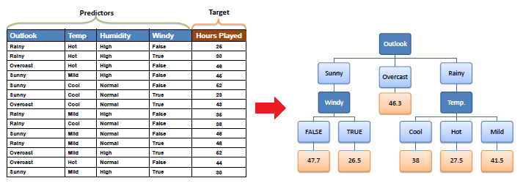

Slide 9
Feature Selection Techniques
FS no | Name | Results (Selected Features)
1 | Select-K-best | K=15 ['Time', 'S_Node', 'Node_id', 'Mac_Type_Pckt', 'Source_IP_Port', 'Packet_Size', 'Hop_Count', 'Broadcast_ID', 'Dest_Node_Num', 'Dest_Seq_Num', 'Src_Node_ID', 'Src_Seq_Num', 'behaviour', 'Type', 'energy_consumption']
2 | Sequential Feature Selector (LR) | K=15 ['Event', 'S_Node', 'Node_id', 'Trace_Level', 'Mac_Type_Pckt', 'Source_IP_Port', 'Des_IP_Port', 'Packet_Size', 'Hop_Count', 'Dest_Node_Num', 'Src_Node_ID', 'behaviour', 'Type', 'rate_of_energy_consumption', 'energy_consumption']
 | Sequential Feature Selector (RFR) | K=15 ['Event', 'Time', 'S_Node', 'Rest_Energy', 'Trace_Level', 'Mac_Type_Pckt', 'Source_IP_Port', 'Des_IP_Port', 'Hop_Count', 'Src_Node_ID', 'behaviour', 'Type', 'rate_of_energy_consumption', 'cumulative_energy_consumption', 'energy_consumption']
 | Sequential Feature Selector (DTR) | K=15 ['Event', 'Time', 'S_Node', 'Node_id', 'Rest_Energy', 'Trace_Level', 'Mac_Type_Pckt', 'Source_IP_Port', 'Des_IP_Port', 'Packet_Size', 'Hop_Count', 'Dest_Node_Num', 'Src_Node_ID', 'behaviour', 'Type']

Slide 10
Compare Regression Techniques
FS Name. | Tech Name | MAE | MSE | RMSE | R²
Kbest | LR | 1.549328418525479 | 12.49766937895140 | 3.53513747021507 | 0.616095372975622
Kbest | RFR | 0.00001620689 | 0.00000838246 | 0.00229581184668 | 0.999999741804088
Kbest | DTR | 0.00000907799 | 0.00000907799 | 0.00194260962448 | 0.999999720381480
SFS | LR | 1.940751829177140 | 16.64387348403998 | 4.07962578019795 | 0.488728055363429
SFS | RFR | 0.001126953104140 | 0.011008437196287 | 0.09897824176914 | 0.999661927584252
SFS | DTR | 0.00000373799 | 0.00000480599 | 0.00093391627902 | 0.999999853130914

Slide 11
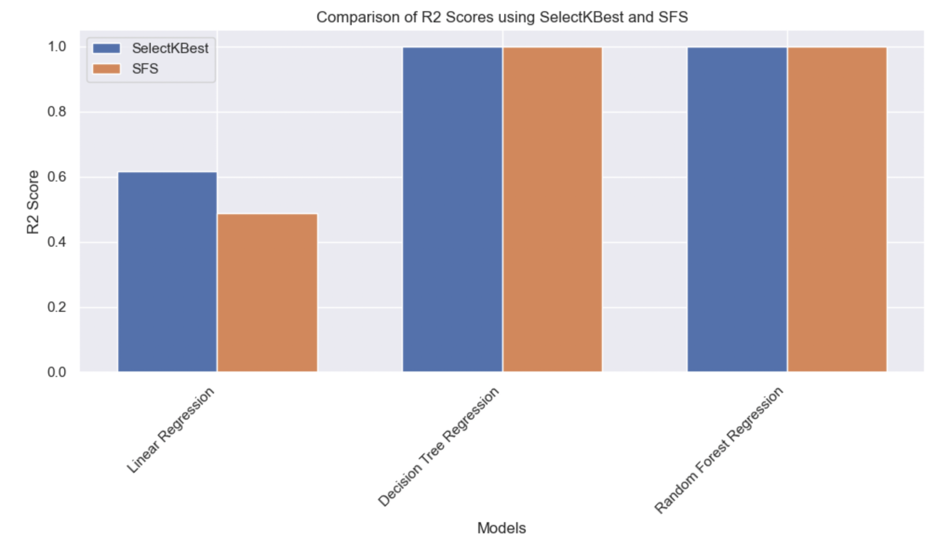
R2 bar plot

Slide 12
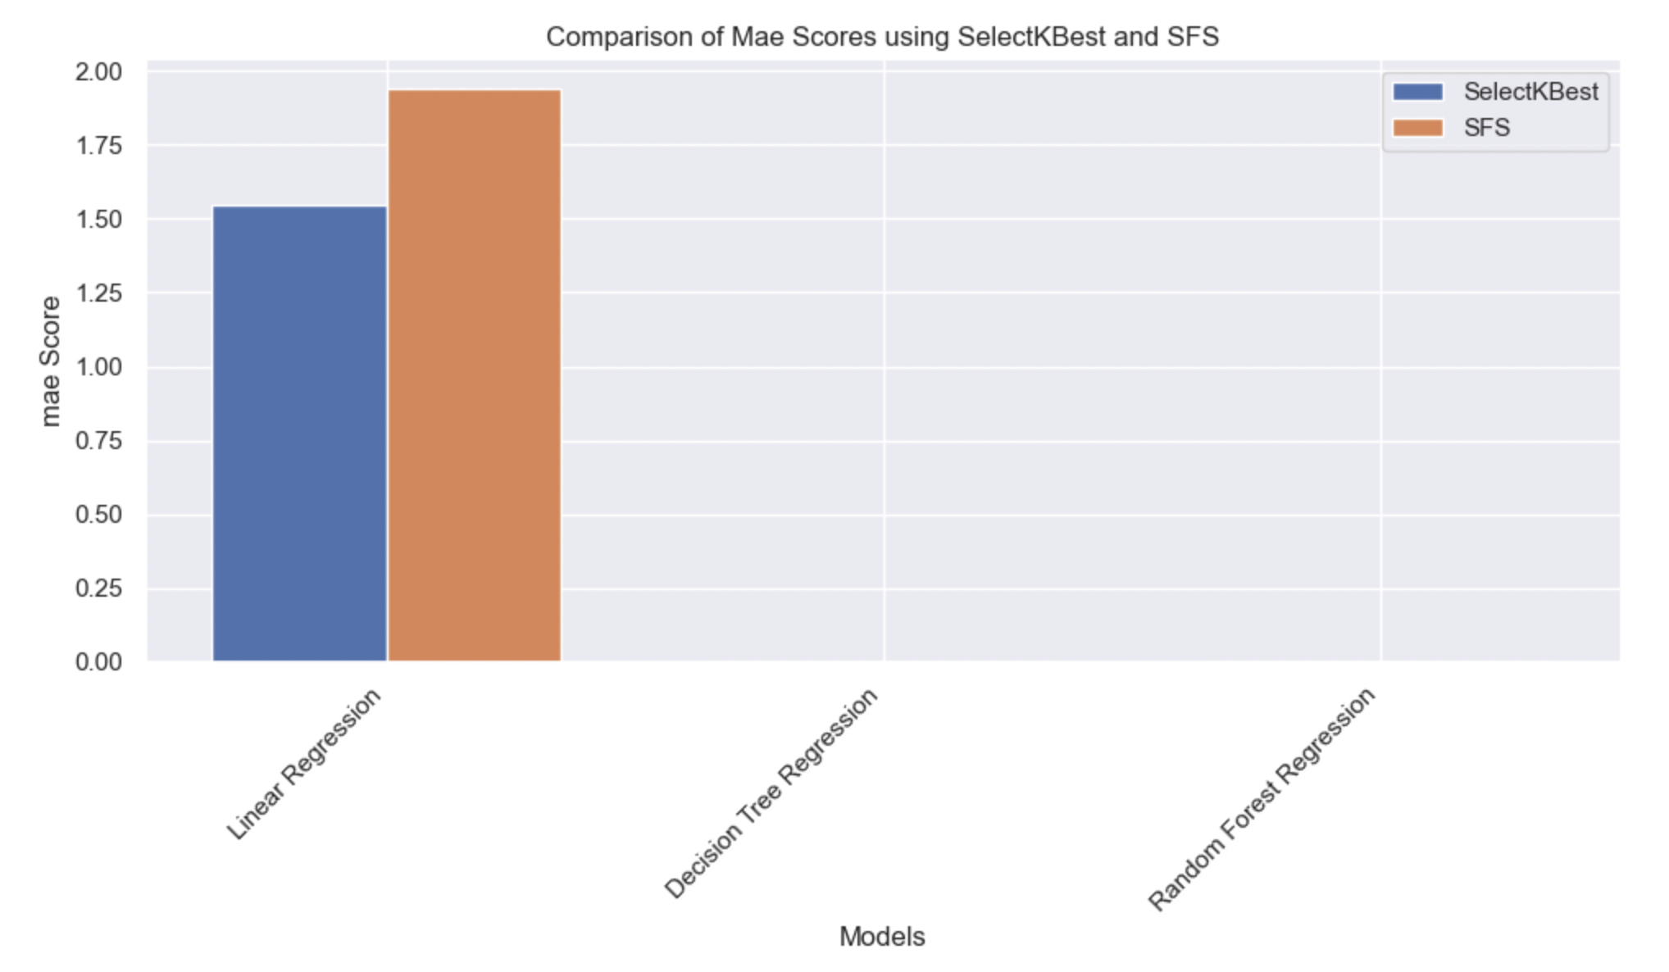
Mae bar plot

Slide 13
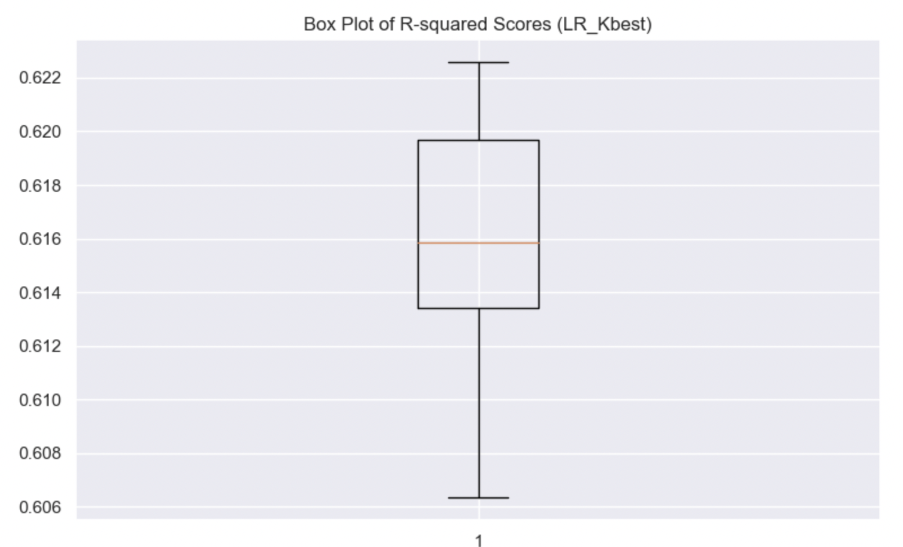
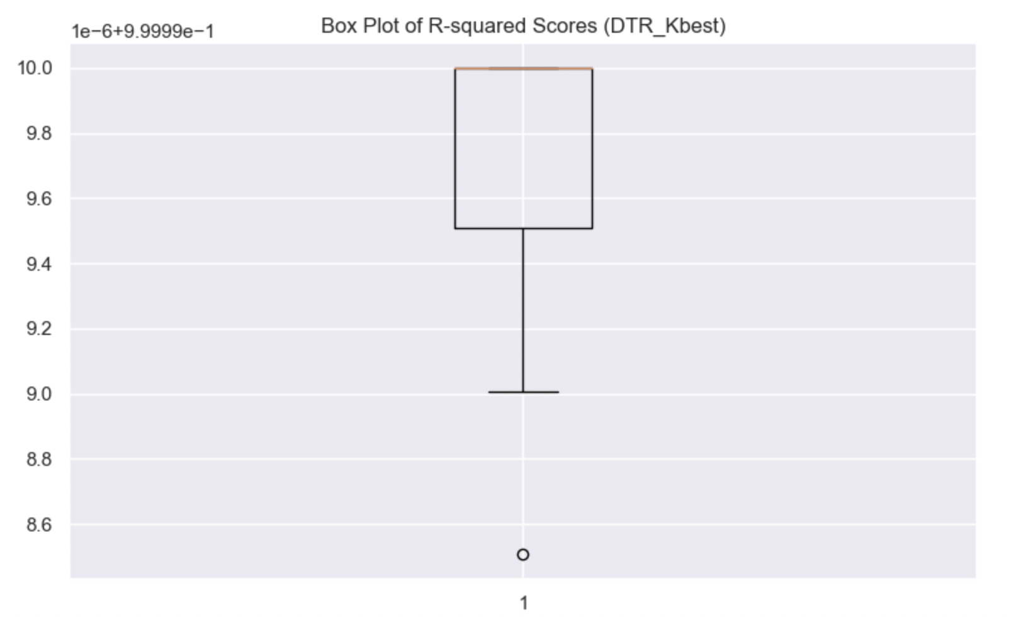
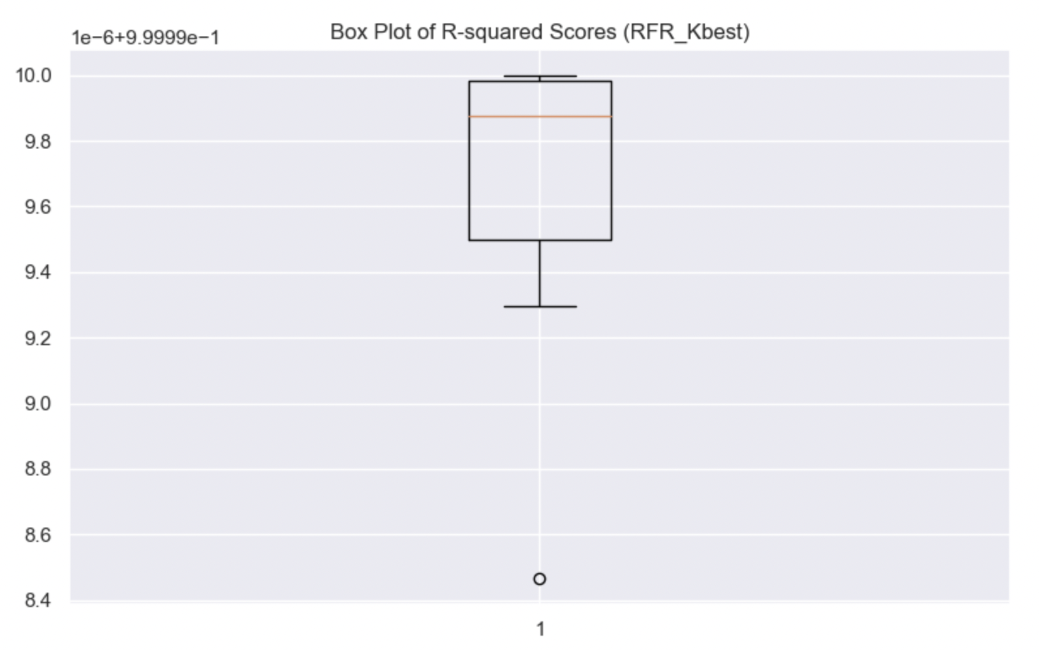
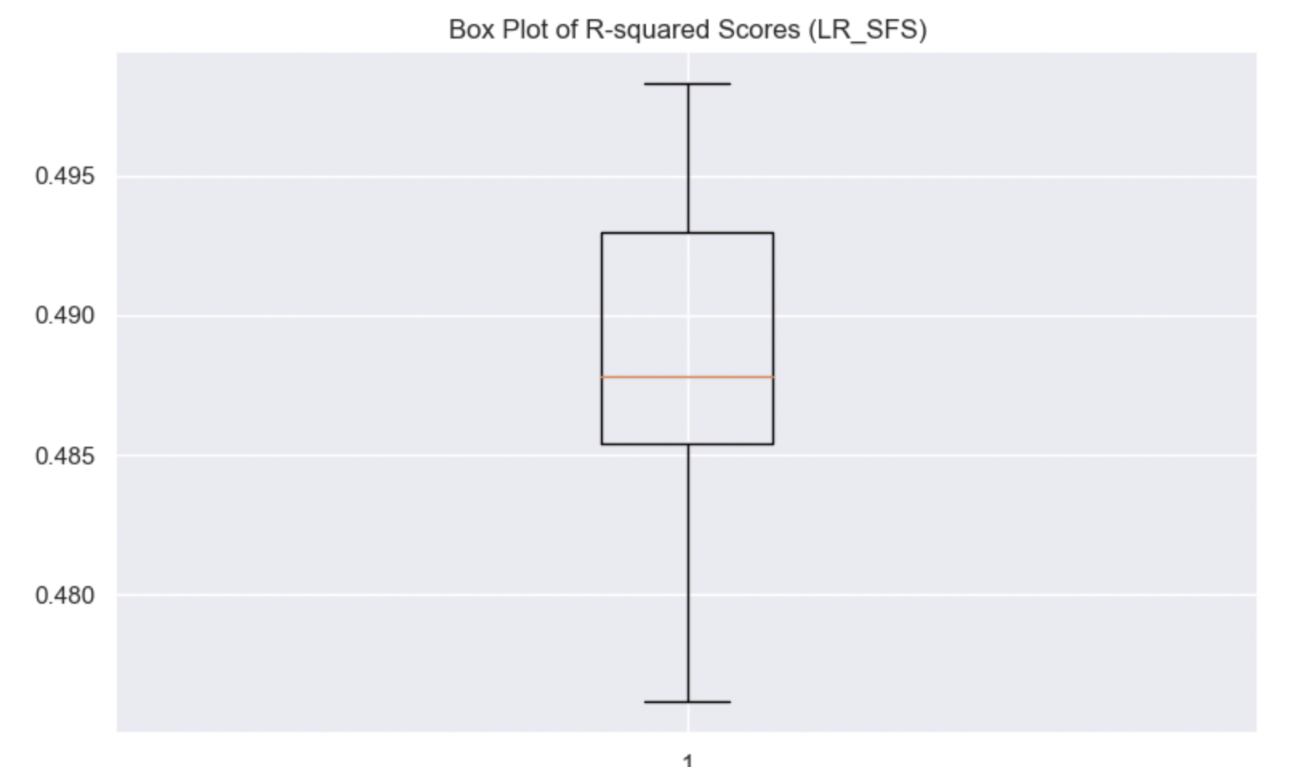
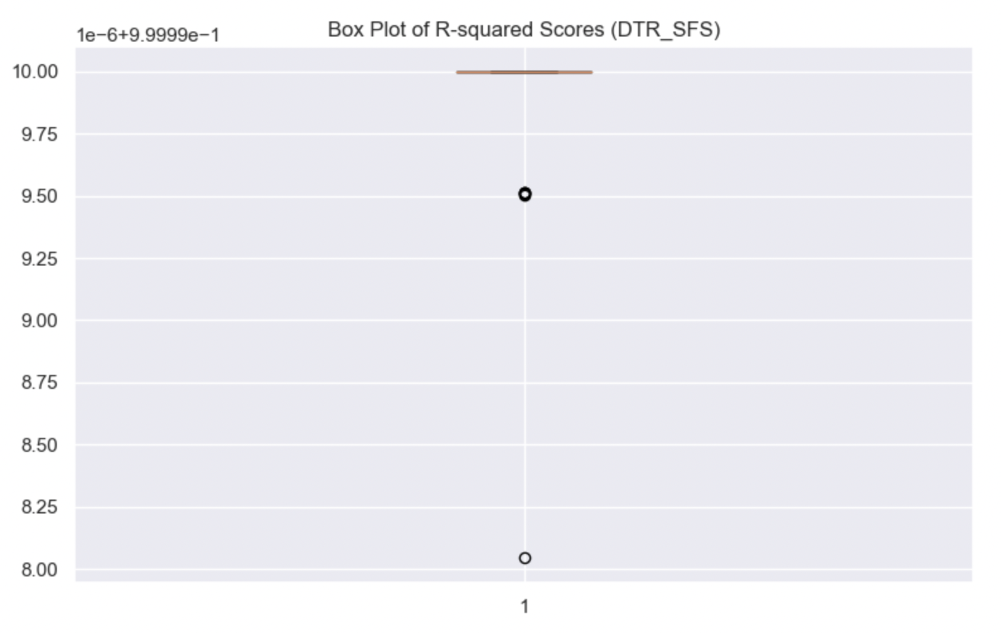
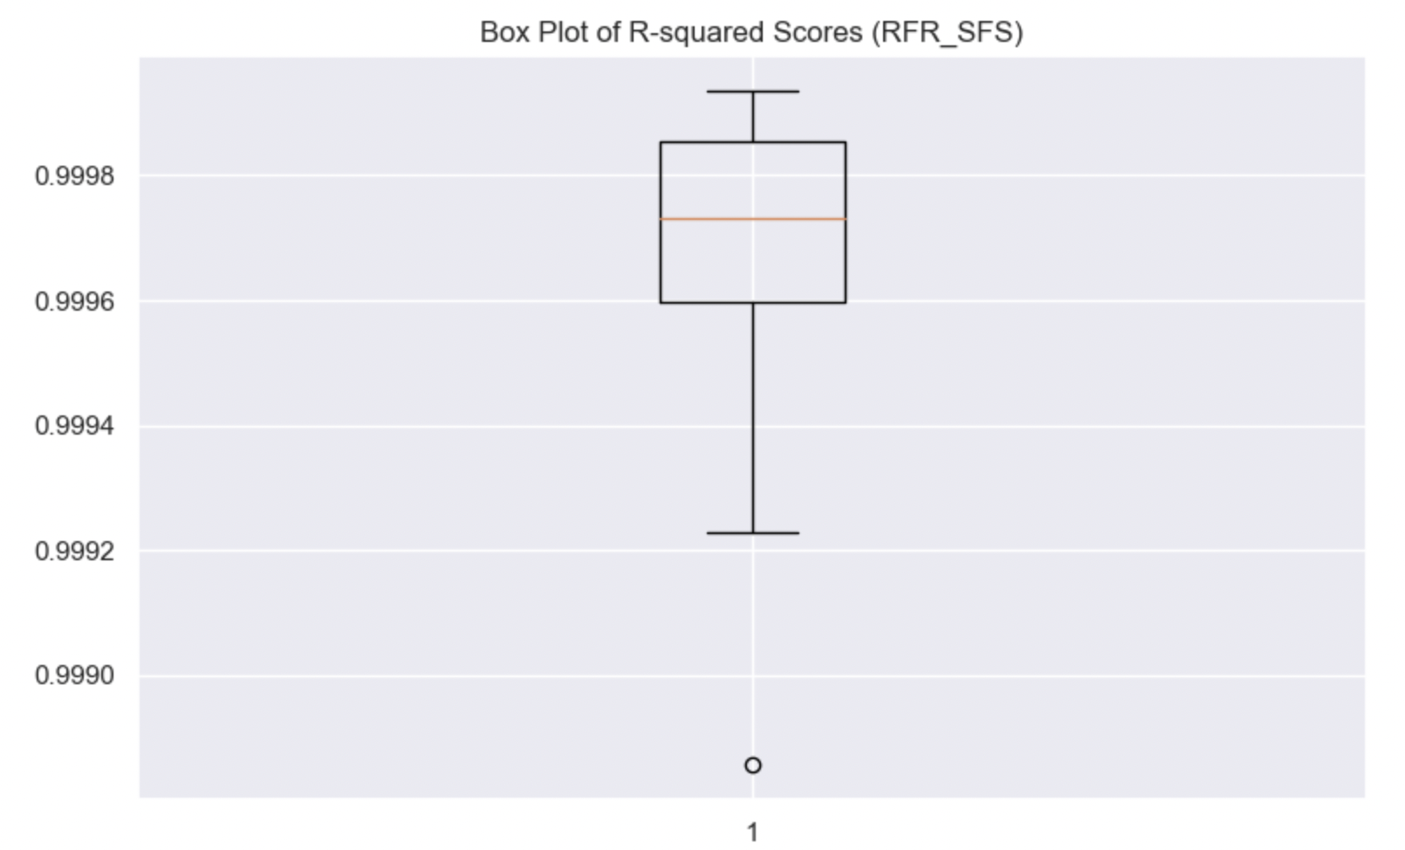
R2 box plot

Slide 14
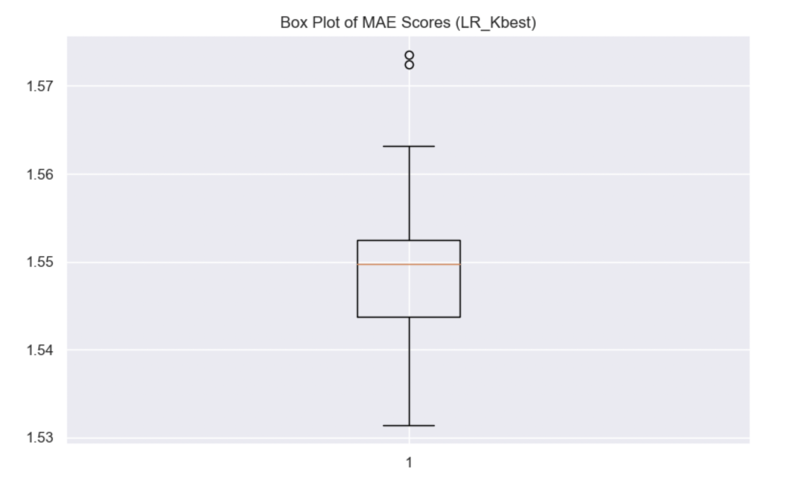
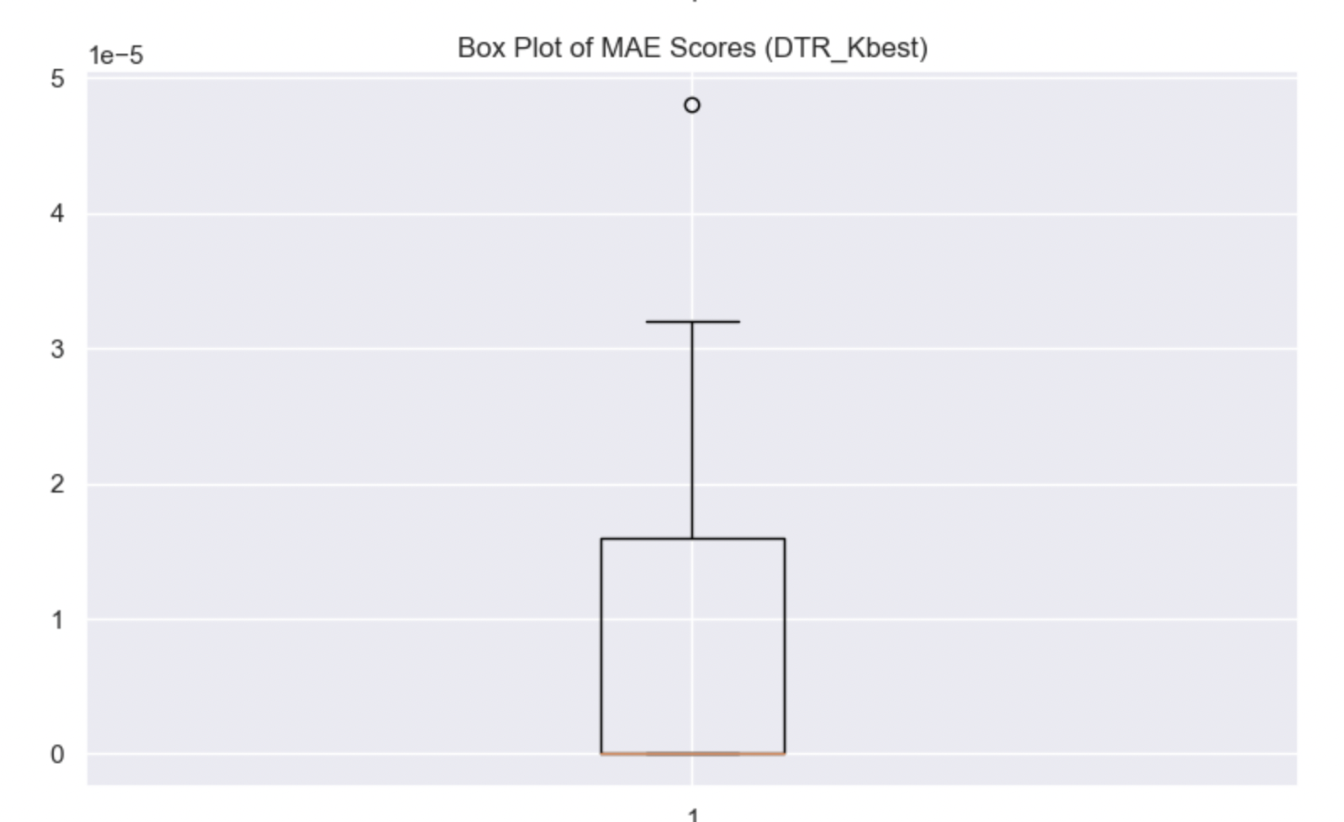
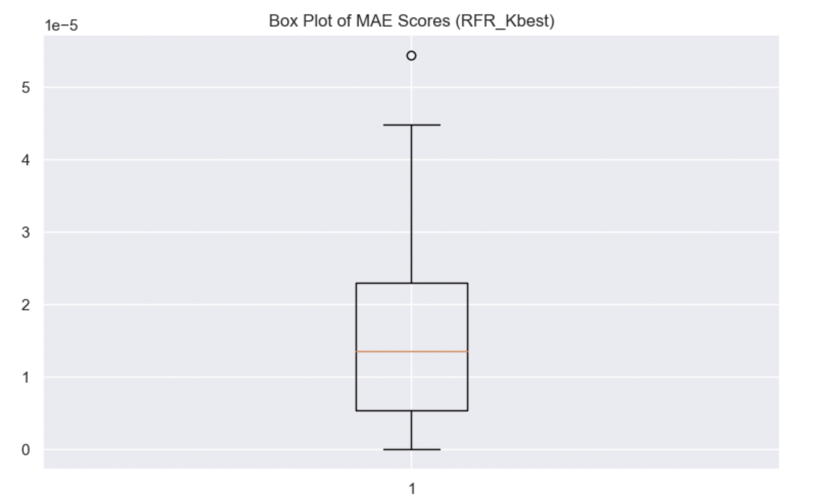
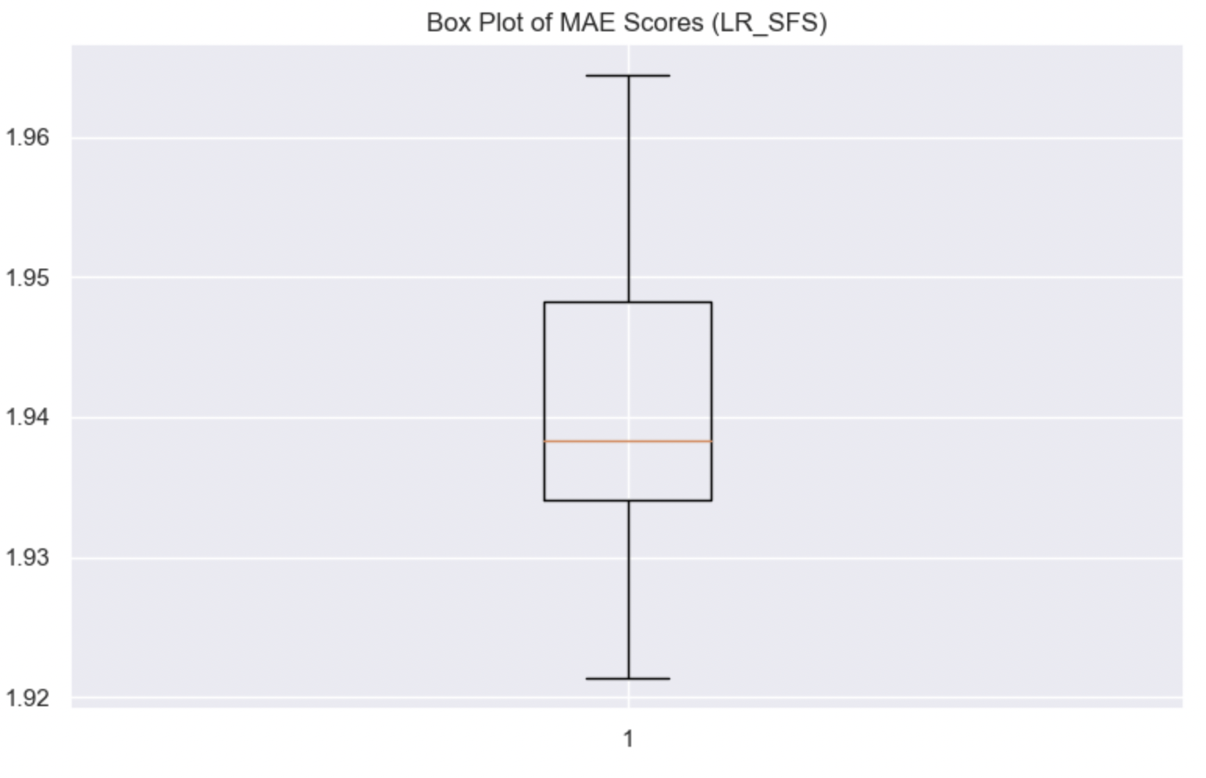
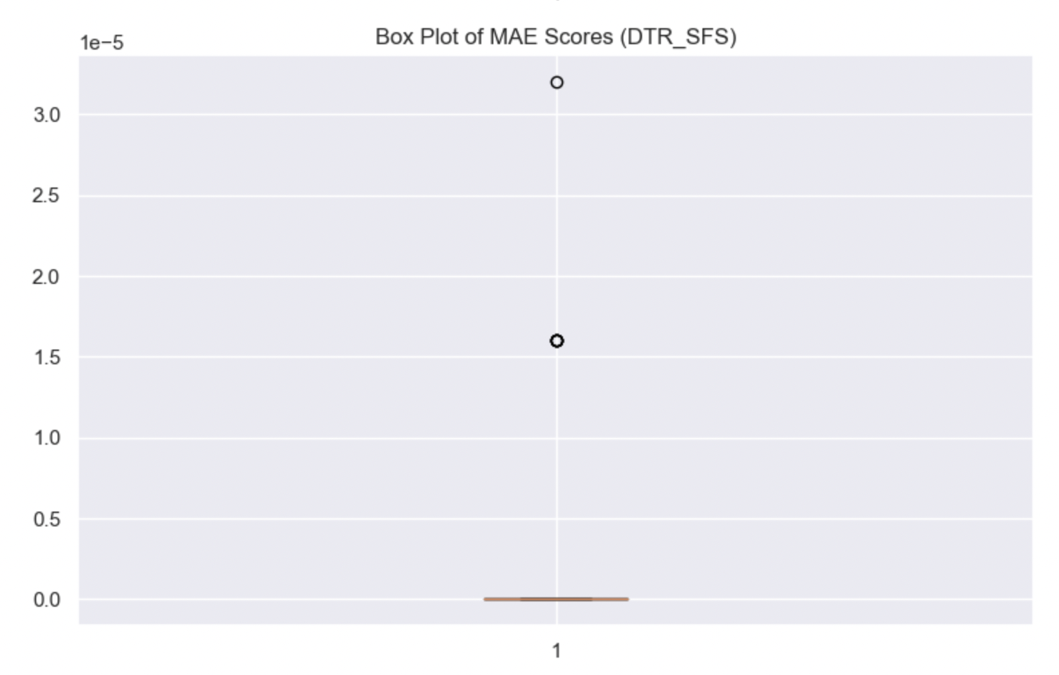
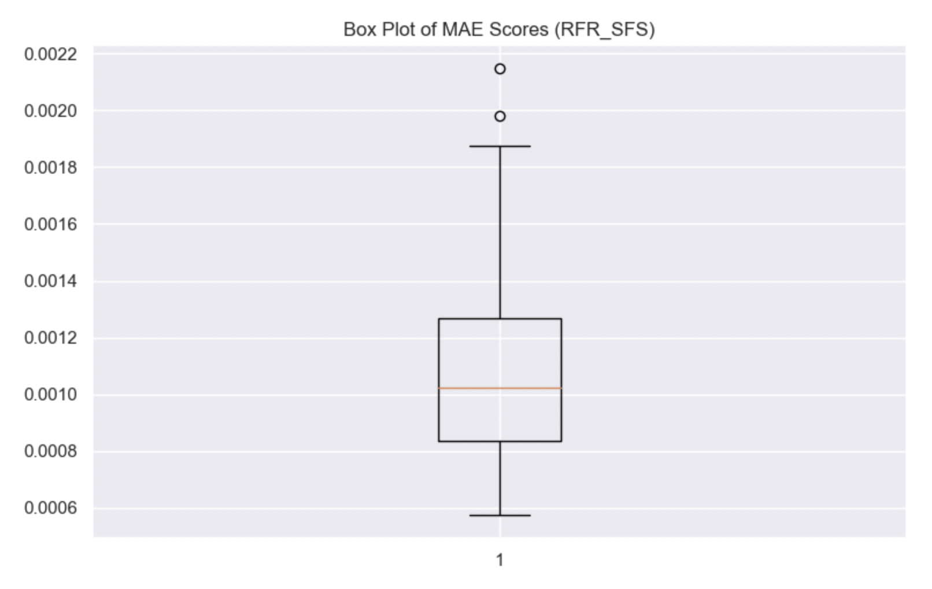
Mae box plot

Slide 15
predicative analytics evaluation:
Rank | Feature Selection | Model | Mae | R2
1 | Kbest | DTR | 0.00000907799 | 0.999999720381480
2 | Kbest | RFR | 0.00001620689 | 0.999999741804088
3 | Kbest | LR | 1.549328418525479 | 0.616095372975622
For K-best, the best model is DTR, followed by RFR and then LR. (The best model is DTR and the worst model is LR)
Rank | Feature Selection | Model | Mae | R2
1 | SFS | DTR | 0.00000373799 | 0.999999853130914
2 | SFS | RFR | 0.001126953104140 | 0.999661927584252
3 | SFS | LR | 1.940751829177140 | 0.488728055363429
For SFS, the best model is also DTR, followed by RFR and then LR. (The best model is DTR and the worst model is LR)

Slide 16
predicative analytics evaluation:
Rank | Model | Feature Selection | Mae | R2
1 | DTR | SFS | 0.00000373799 | 0.999999853130914
2 | DTR | Kbest | 0.00000907799 | 0.999999720381480
3 | RFR | Kbest | 0.00001620689 | 0.999999741804088
4 | RFR | SFS | 0.001126953104140 | 0.999661927584252
5 | LR | Kbest | 1.549328418525479 | 0.616095372975622
6 | LR | SFS | 1.940751829177140 | 0.488728055363429
The best feature selection for the DTR model is SFS
The best feature selection for the RFR model is K-best
The best feature selection for the LR model is K-best
The worst model for both feature selection was the LR model
The best model for both feature selection was the DTR

Slide 17
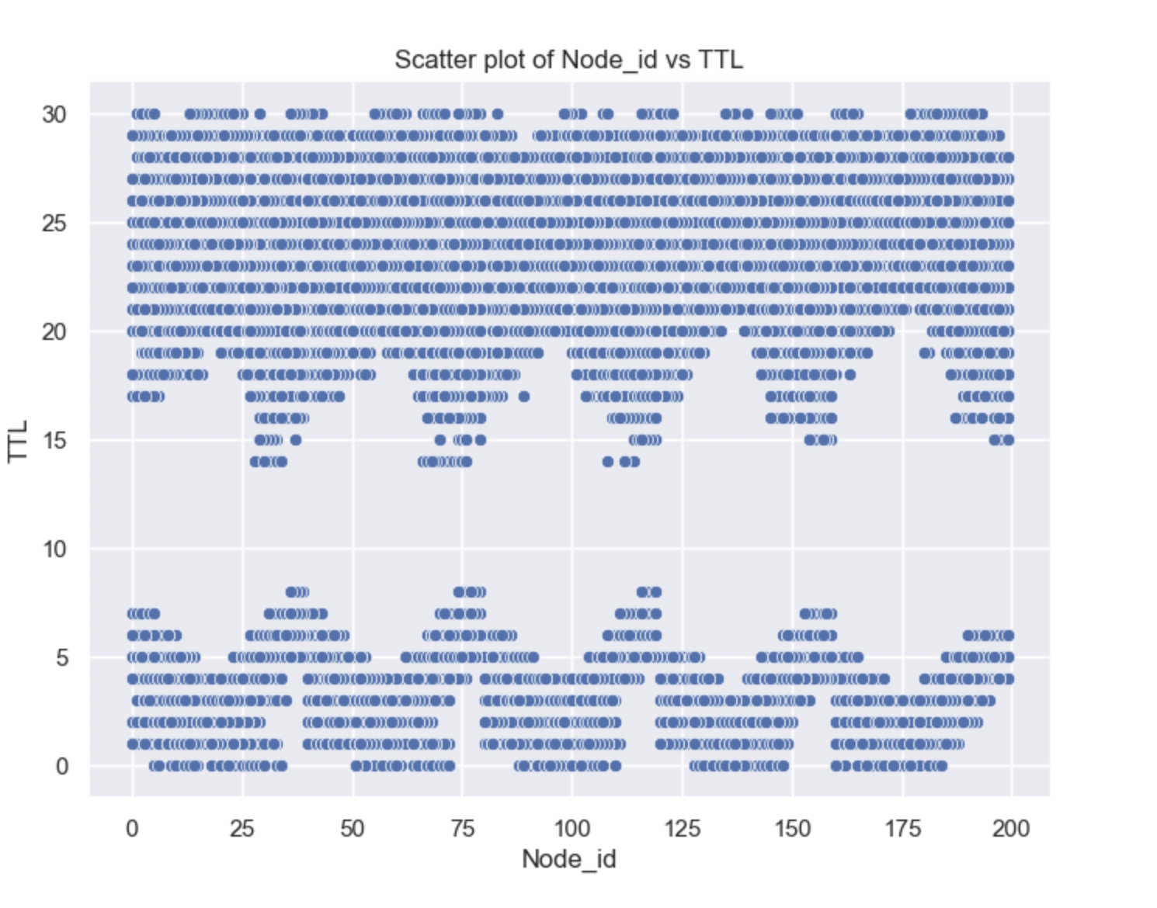
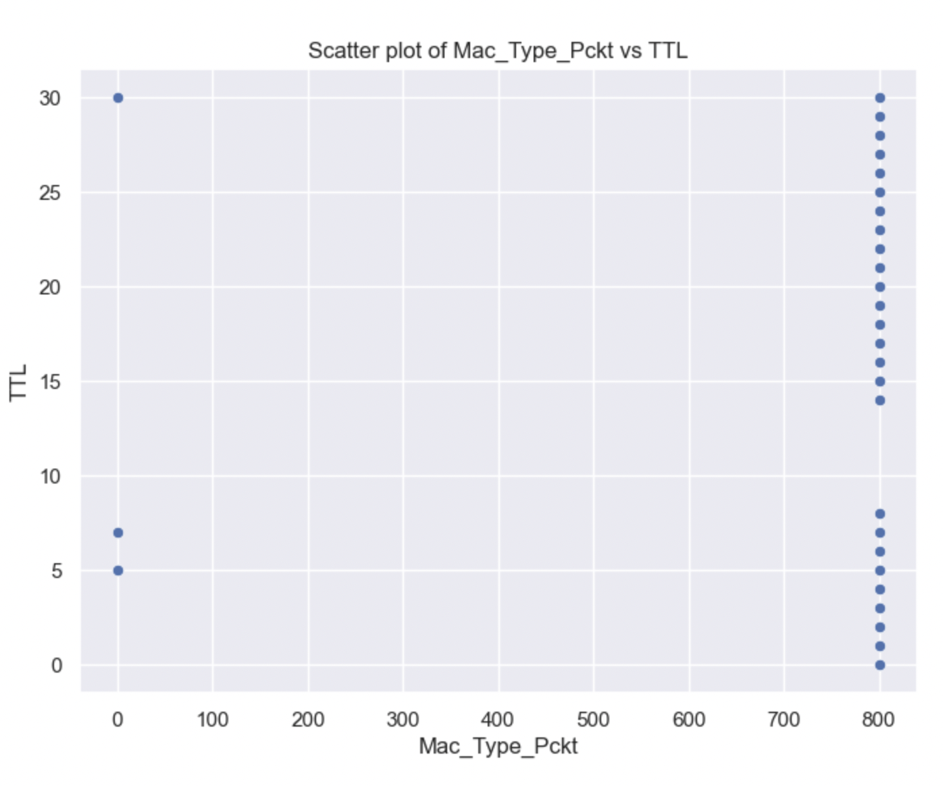
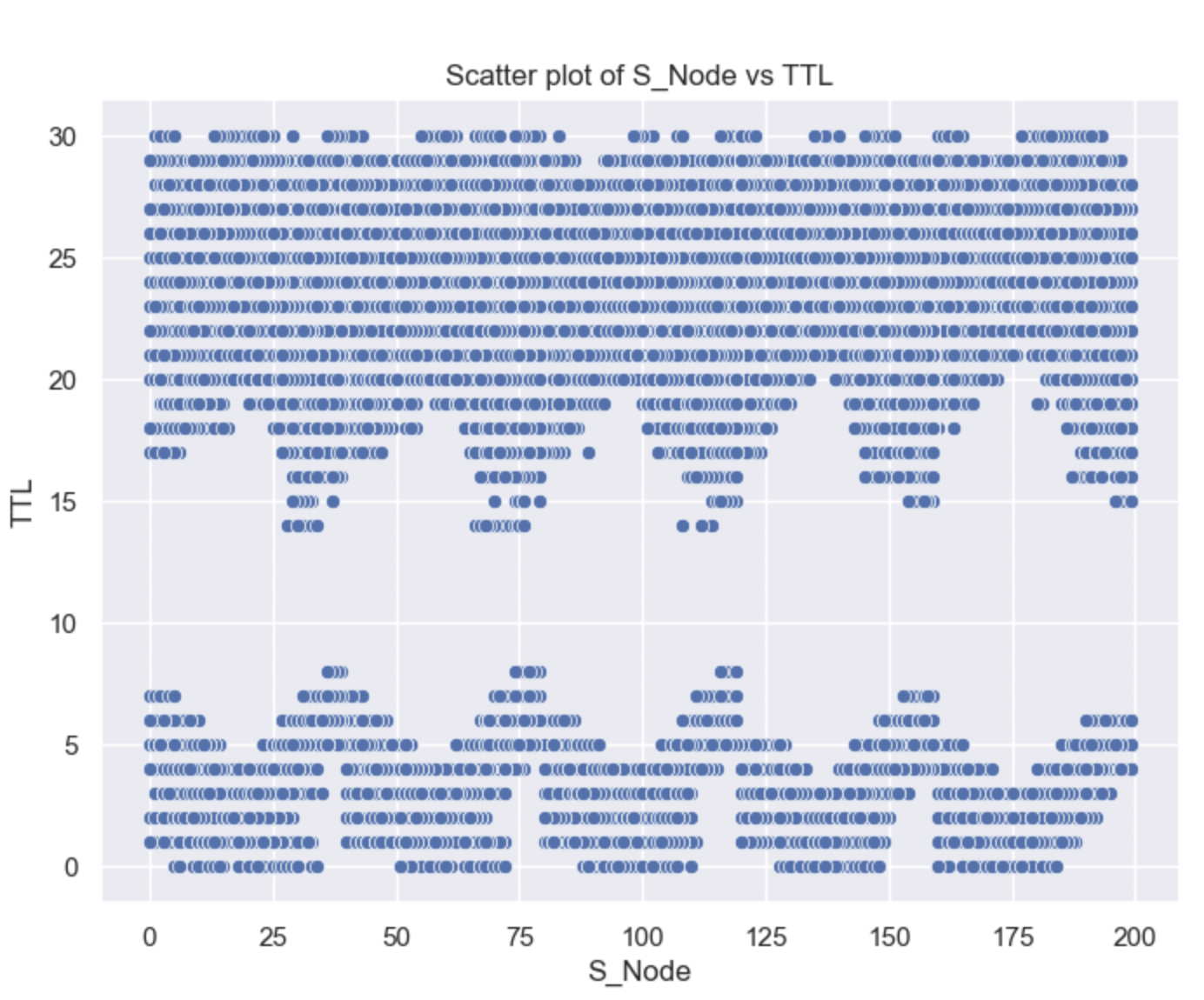
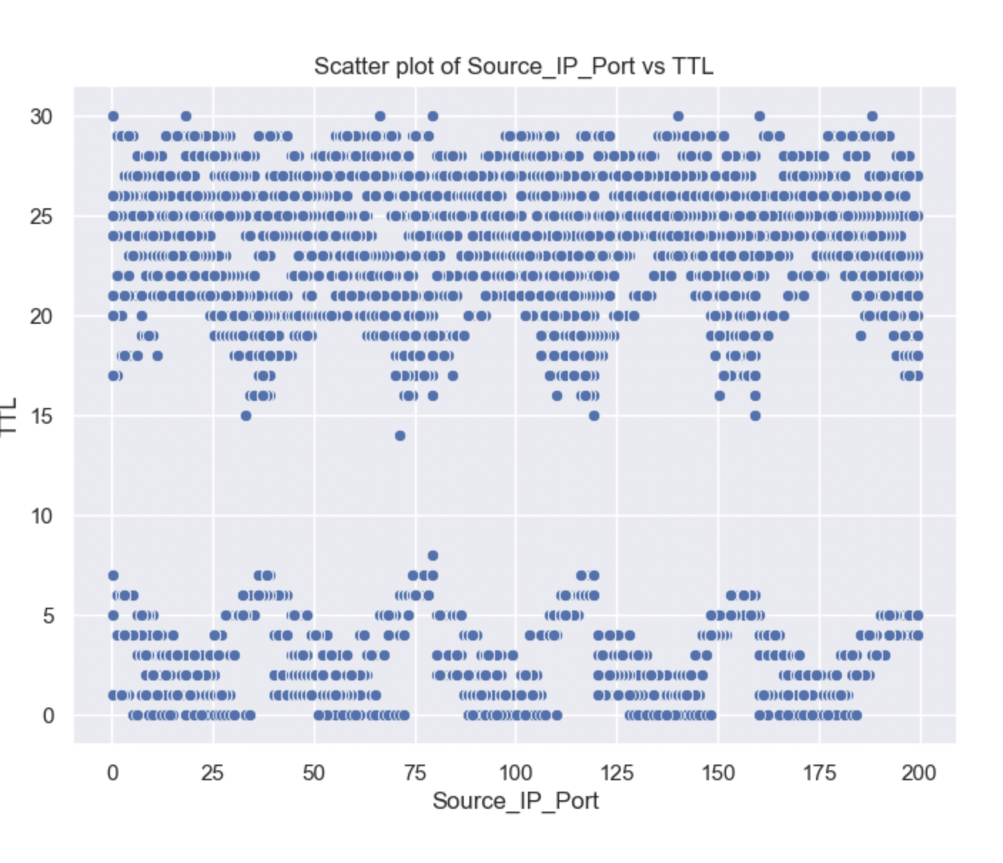
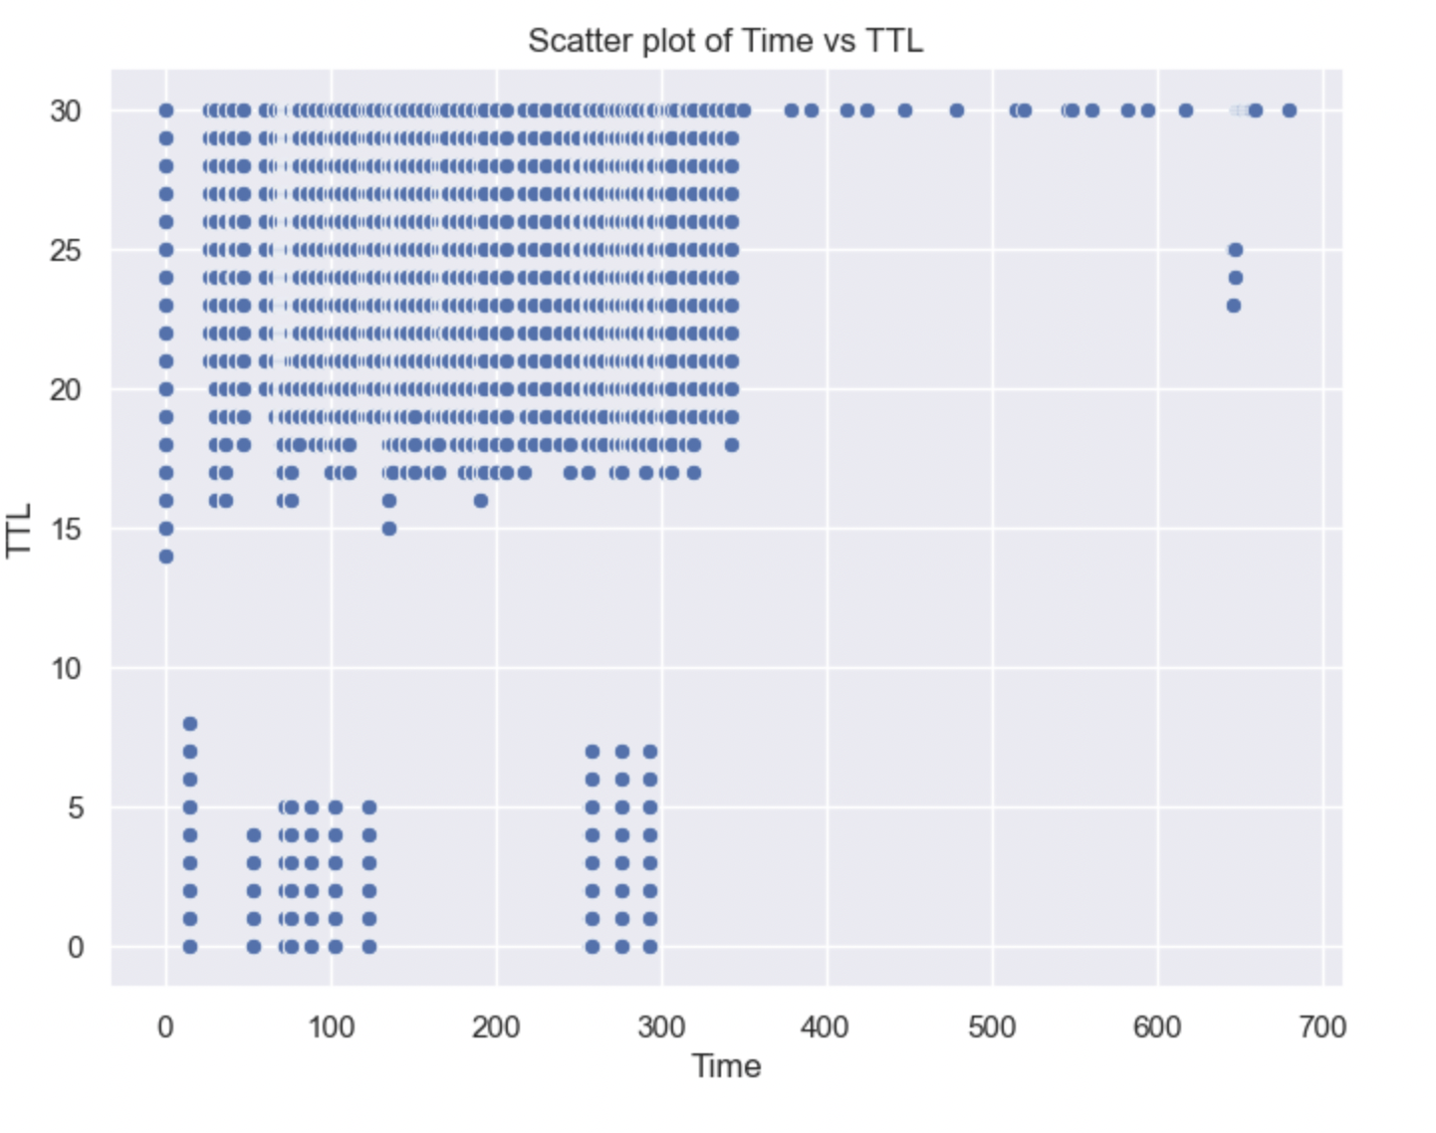
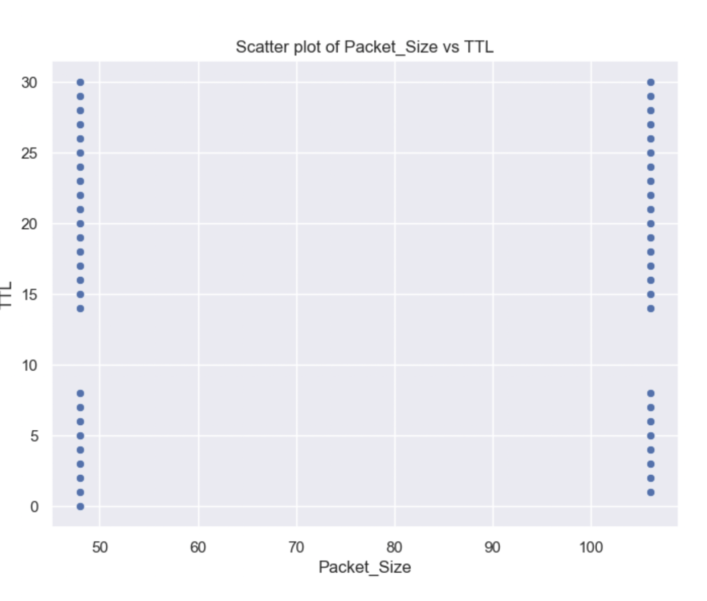
Why the LR model was the worst model
The first reason might be the nature of the data set (selected features)
As you can see that the relation between the target feature which is the TTL and the selected features is not linear

Slide 18
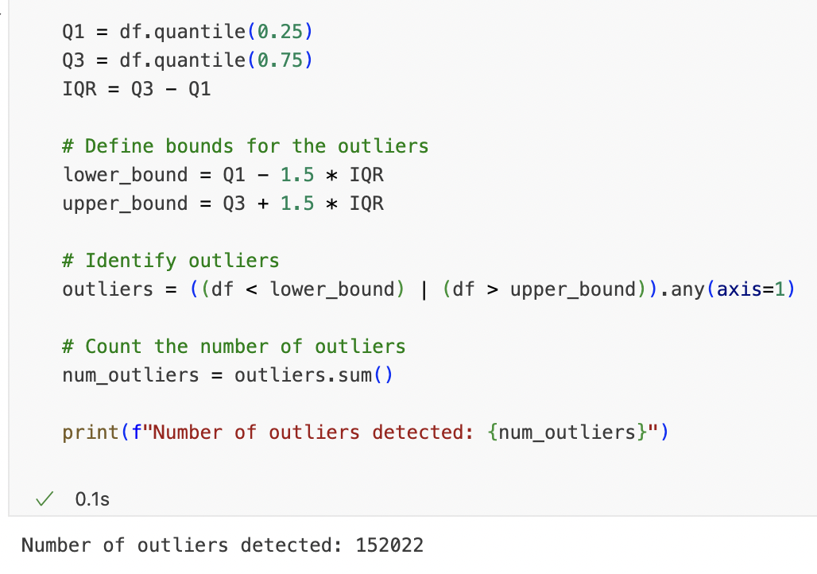
Why the LR model was the worst model

Slide 19
Improvements for the LR model:
We can use another feature selection that is more friendly to LR
1
We can remove Outlier Detection because the effectiveness of linear regression can be significantly impacted by outliers.
LR is sensitive to outliers because it tries to find a "best fit" line
2

Slide 20
Prescriptive Analytics

Slide 21
Prescriptive Analytics Techniques
Optimization:
What is the Optimization technique?
is a field of mathematics focused on finding the best possible solutions to a problem within a set of given constraints. (sam, 2017) (Britannica, 2023)
The "best" solution is often defined in terms of maximizing or minimizing a particular value, such as profit or cost. (sam, 2017) (Britannica, 2023)

Slide 22
How it works?
By using mathematical models and algorithms, it identifies the best course of action to achieve a specific goal while meeting constraints.
(sam, 2017) (Britannica, 2023)
Examples of some algorithms used to solve problems:
Linear Programming, Integer Programming (sam, 2017) (Britannica, 2023)
Application:
Supply Chain Management: Optimize inventory levels to reduce costs
Finance: Portfolio optimization to maximize returns
(sam, 2017) (Britannica, 2023)
Tools might be used to help the model to solve:
IBM CPLEX, Gurobi, MATLAB
(sam, 2017) (Britannica, 2023)

Slide 23
Prescriptive Analytics Techniques
Simulation:
What is the Simulation technique?
used to model and analyze complex systems
The purpose of simulation is often to generate useful data or insights that can inform decisions
allows you to observe outcomes under different sets of conditions, enabling risk assessment
(Academic, 2021) (Simulation, 2022)

Slide 24
How it works:
computational modeling of a system with iterative simulation runs to identify optimal solutions within a defined set of criteria. It utilizes real-world-like scenarios to guide decision-making.
to understand its behavior under different conditions. (Academic, 2021) (Simulation, 2022)
Examples of some algorithms used to solve problems:
Monte Carlo Simulation (Academic, 2021) (Simulation, 2022)
Applications:
Healthcare: Simulate patient arrival rates, treatment times, and resource availability to optimize staffing and minimize wait times.
Marketing: Simulate customer behavior to identify best promotional strategy
(Academic, 2021) (Simulation, 2022)
Tools might be used to help the model to solve:
AnyLogic, Arena Simulation Software (Academic, 2021) (Simulation, 2022)

Slide 25
Prescriptive Analytics Techniques
Decision Analysis:
What is the Decision Analysis technique?
Decision Analysis systematically evaluates different decisions to select the best choice.
(Decision Analysis, 2022) (patric, 2019)

Slide 26
How it works:
Utilizes decision trees, payoff tables, and utility functions to quantify the impact of various decision options.
(Decision Analysis, 2022) (patric, 2019)
Examples of some algorithms used to solve problems:
Decision Trees
(Decision Analysis, 2022) (patric, 2019)
Applications:
Strategic Planning: Selecting the best market for expansion
Policy Making: Evaluating the impacts of different policy options
(Decision Analysis, 2022) (patric, 2019)
Tools might be used to help the model to solve:
DecisionTools Suite, Microsoft Excel's Decision Tree Add-ins
(Decision Analysis, 2022) (patric, 2019)

Slide 27
Objective Function Code

Slide 28
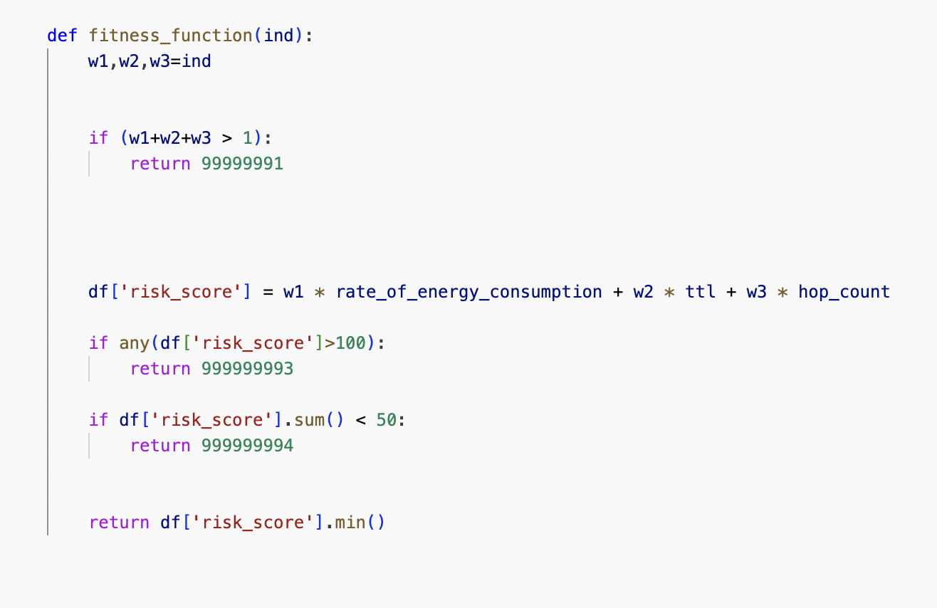
Objective Function Code (Your Work)

Slide 29
Results and Explanation
GA:
Best solution is [0.3199059045865893, 0.668997243828676, 0.0009042492845308114]
fitness 0.004521246422654057
run 10
generation 93
PSO:
Best solution is [0.3696740251976166, 0.4299038744018192, 0]
fitness 0.0
run 1
iteration 2
The PSO is better that GA because the fitness value is lower than the fitness value of the GA

Slide 30
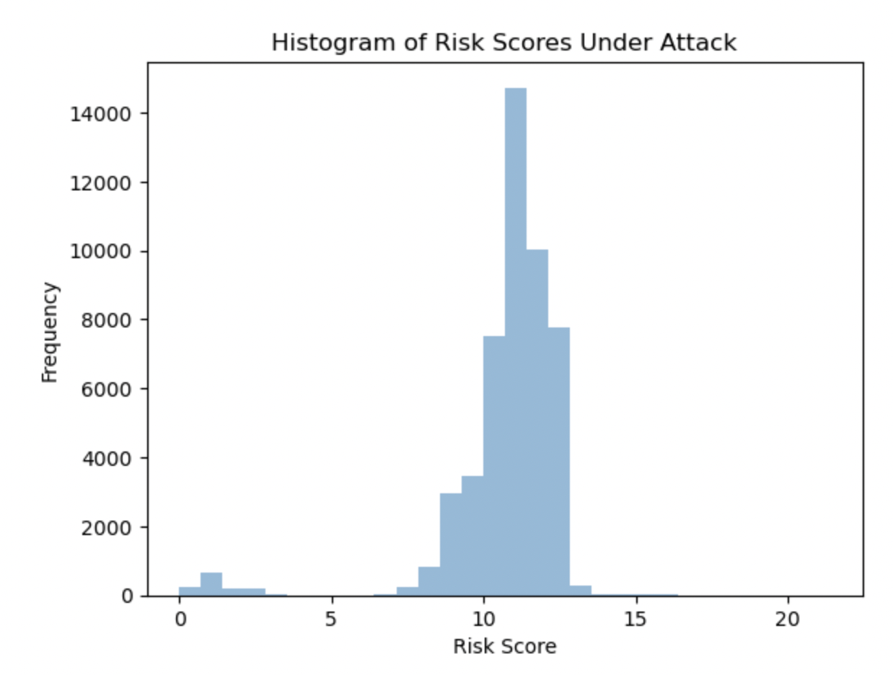
Results and Explanation threshold:

Slide 31
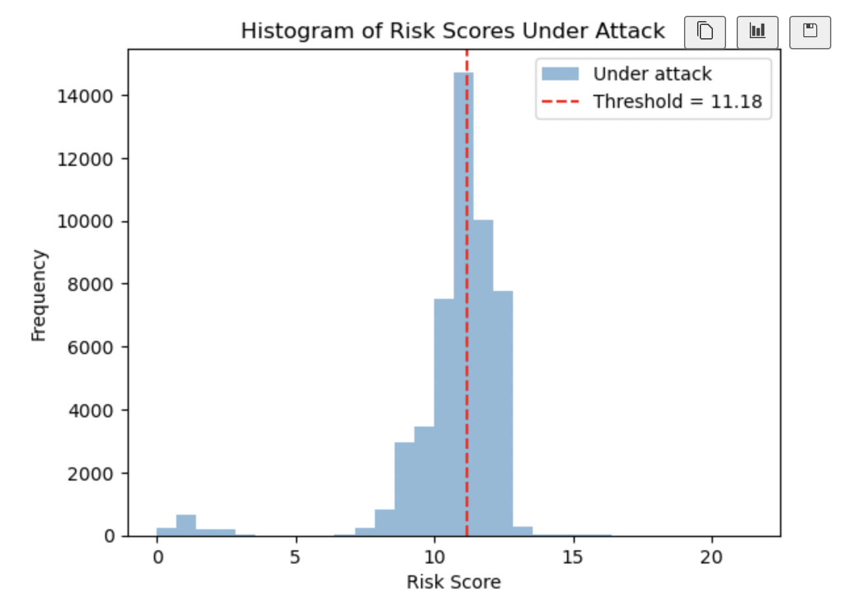
Results and Explanation threshold:

Slide 32
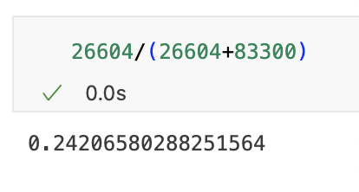
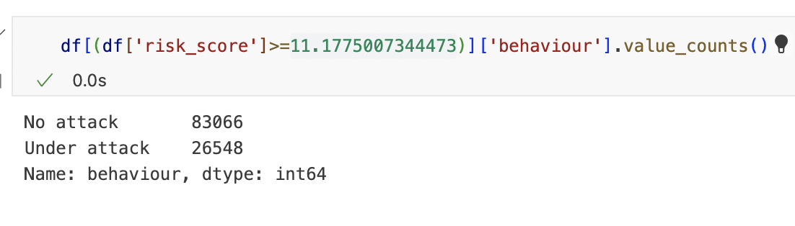
Results and Explanation
One of the reasons to choose this value as a threshold :
Because it has the biggest isolation and gave me the highest result percentage so I can specify and be more critical to locate the possibility of having attack

Slide 33
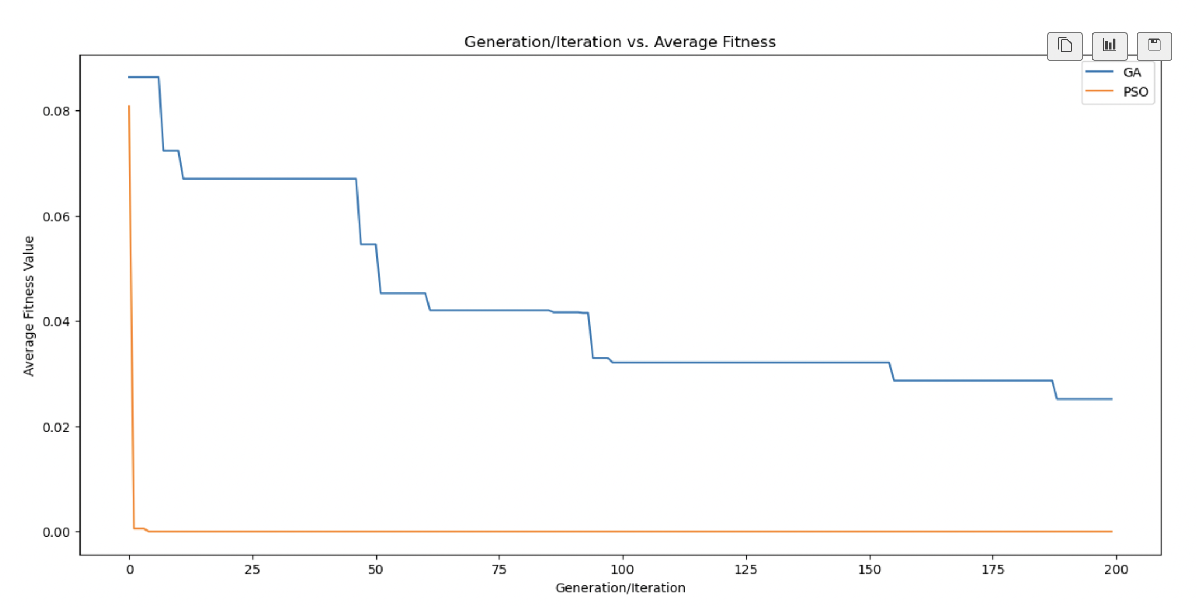
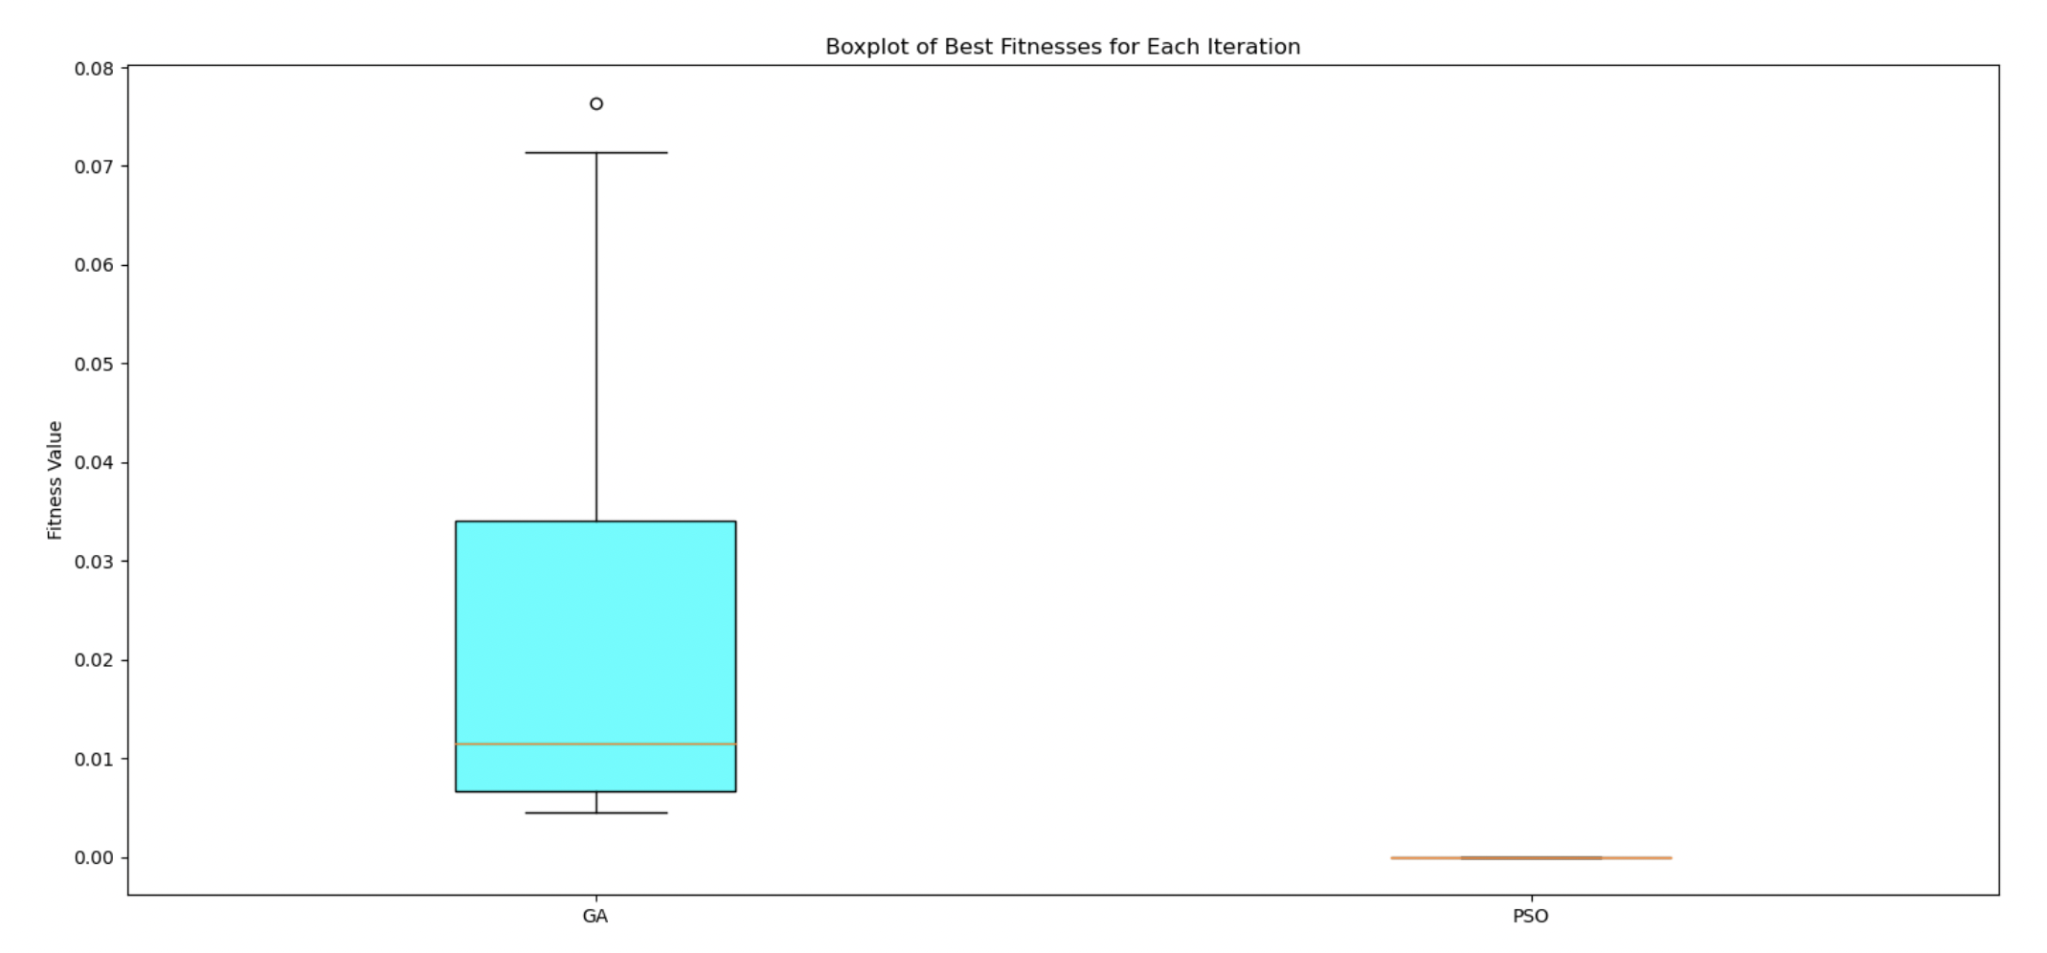
Visualization and Explanation
As we can see that the PSO is better than the GA

Slide 34
References
Selectkbest, S. (2014) Sklearn.feature_selection.Selectkbest, scikit. Available at: https://scikit-learn.org/stable/modules/generated/sklearn.feature_selection.SelectKBest.html (Accessed: 05 September 2023).
Malato, G. (2023) A practical introduction to sequential feature selection, Your Data Teacher. Available at: https://www.yourdatateacher.com/2023/02/15/a-practical-introduction-to-sequential-feature-selection/ (Accessed: 05 September 2023).
Mali, K. (2023) Everything you need to know about linear regression!, Analytics Vidhya. Available at: https://www.analyticsvidhya.com/blog/2021/10/everything-you-need-to-know-about-linear-regression/ (Accessed: 05 September 2023).
Beheshti, N. (2022) Random Forest regression, Medium. Available at: https://towardsdatascience.com/random-forest-regression-5f605132d19d (Accessed: 05 September 2023).
Stan (2021) Decision_tree_regressor_deepdive, Medium. Available at: https://medium.com/@Stan_DS/decision-tree-regressor-deepdive-875b5fd58813 (Accessed: 05 September 2023).
sam, sam (2017) Optimization techniques - sam Houston State University, Houston State. Available at: https://www.shsu.edu/~eco_dgf/web_chapter_a.pdf (Accessed: 05 September 2023).
Britannica, B. (2023) Optimization, Encyclopædia Britannica. Available at: https://www.britannica.com/science/optimization (Accessed: 05 September 2023).
Academic, A. (2021) Academic.oup.com. Available at: https://academic.oup.com/bioinformatics/article/35/20/4072/5418953 (Accessed: 05 September 2023).

Slide 35
Simulation, vSimulation (2022) Simulation technique, Simulation Technique - an overview | ScienceDirect Topics. Available at: https://www.sciencedirect.com/topics/engineering/simulation-technique#:~:text=Simulation%20techniques%20consist%20in%20sampling,respect%20to%20the%20simulation%20budget. (Accessed: 05 September 2023).
\
Decision Analysis, A. (2022) Decision analysis, Decision Analysis - an overview | ScienceDirect Topics. Available at: https://www.sciencedirect.com/topics/earth-and-planetary-sciences/decision-analysis#:~:text=Decision%20analysis%20is%20a%20formalized,means%20of%20these%20outcome%20measures. (Accessed: 05 September 2023).
patric (2019) Decision analysis - definition, tree, explanation, examples. Available at: https://www.wallstreetmojo.com/decision-analysis/ (Accessed: 05 September 2023).

